Slide 1
SQL Map – Solving the Cookies NOT Set Issue

Slide 2
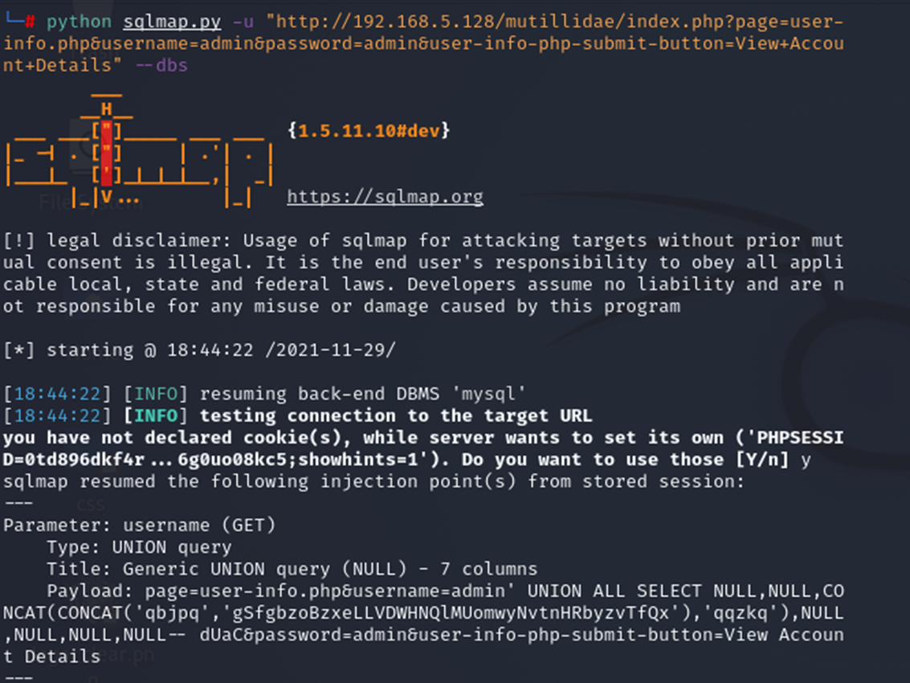
How to solve this issue? Is OK to make use of the cookie generated by the server.

Slide 3
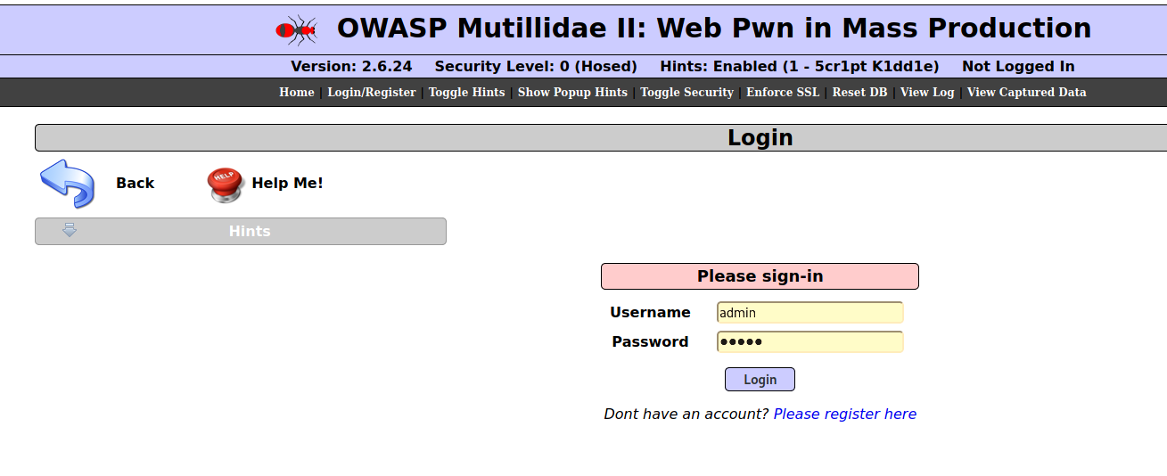
Go to the web where we are going to use it for sql injection attack

Slide 4
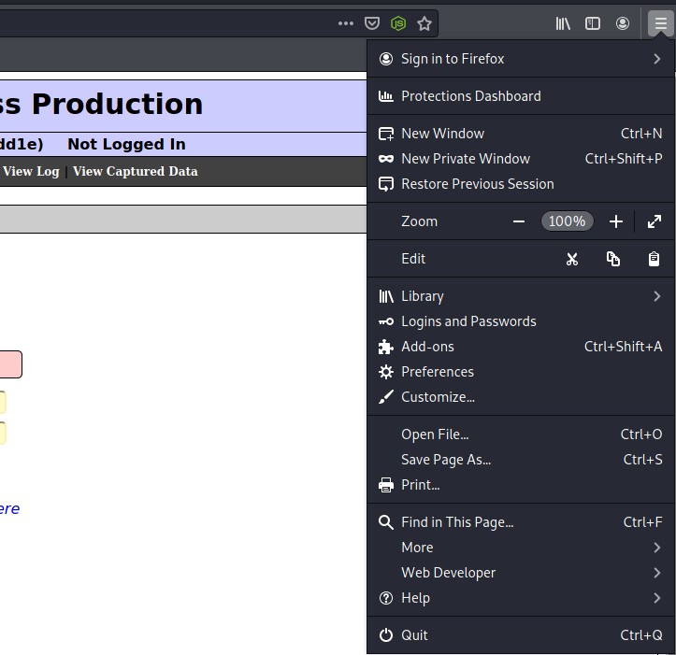
Select [Web Developer] in the browser menu

Slide 5
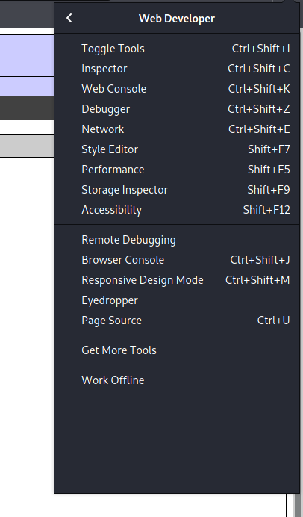
Select [Inspector] …

Slide 6
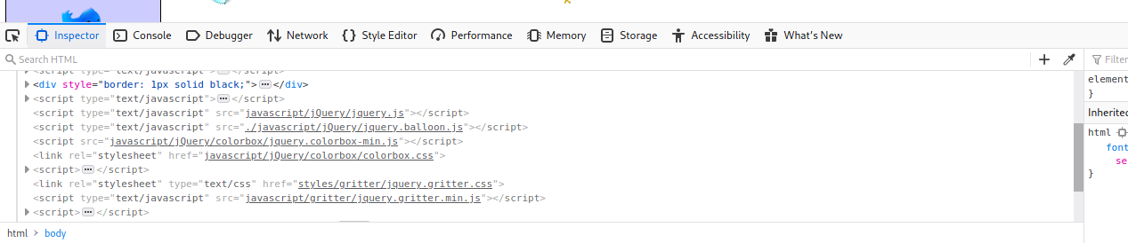
Select [Console] …

Slide 7
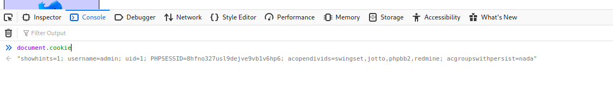
Enter document.cookie, cookie use for that session will appear
Highlight and copy this string into the clipboard

Slide 8
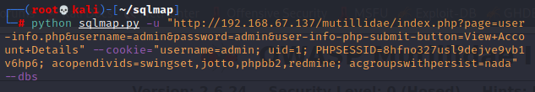
Add into the command string and that problem will go away,,,

